Slide 1

EDA of AMCAT Data

Slide 2
About me
Myself N. Paul Gabriel Richman
Completed my graduation as a Mechanical Engineer in 2018 from ITM University Gwalior, M.P
Completed my Post graduation as a Petroleum Engineer in 2022 from JNTU Kakinada
This field holds the key to gaining a competitive edge in the market.
The way Data science uses the combination of Machine Learning with Statistics and Calculus is fascinating
I want to build my career in this field and contribute to the fullest
Currently Doing an Internship at Innomatics Research Labs
On LinkedIn(https://www.linkedin.com/in/paulrichman1/)
On GitHub(https://github.com/PaulRichman)

Slide 3
Objective of the Project The objective of the project is to predict the salary of individuals based on various factors such as education level, job title, location, etc. Therefore, the EDA would focus on understanding the relationships between these variables and the target variable (Salary), identifying important features, and building predictive models to predict salary. Understand the Data: Look at the structure of the dataset, including the number of rows and columns, data types, and column names. This helps in understanding what kind of data we are dealing with. Descriptive Statistics: Compute descriptive statistics such as mean, median, mode, standard deviation, and quartiles to summarize the central tendency, dispersion, and shape of the dataset. Data Visualization: Use various plots such as histograms, box plots, scatter plots, and correlation matrices to visualize the distribution of individual variables, and relationships between variables, and identify patterns and trends in the data. Outlier Detection: Identify outliers in the dataset and decide whether to remove them or treat them separately.
Exploratory Data Analysis:
Data Cleaning and Data Manipulation:
I checked for null there were none. Named an Unnamed Column.
Checked for Outliers in Numerical Columns using Box Plot. Using the IQR method Removed Outliers.
Data Transformation: Convert data types of columns, From object to datetime64[ns]

Slide 4
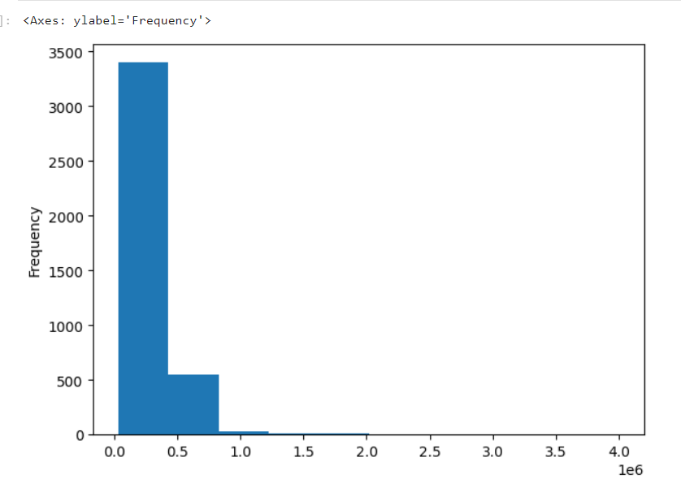
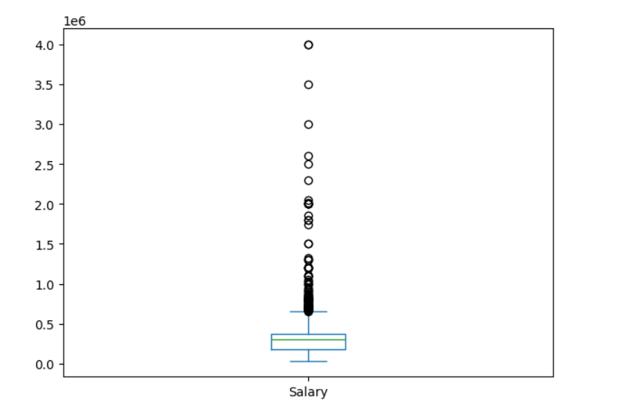
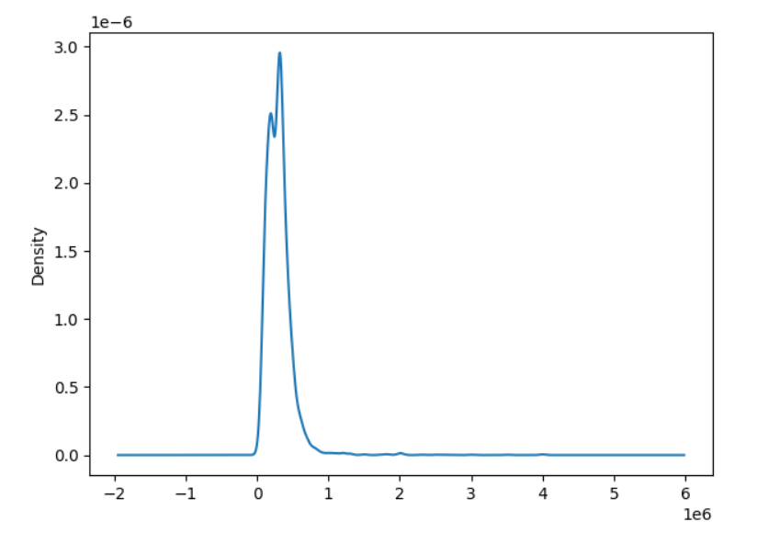
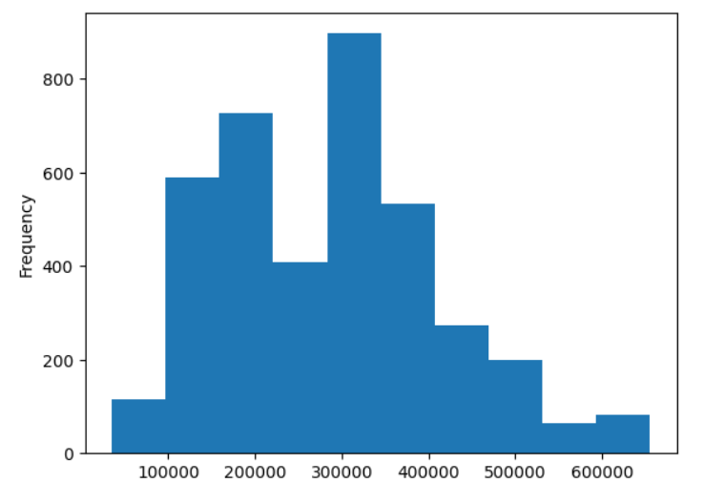
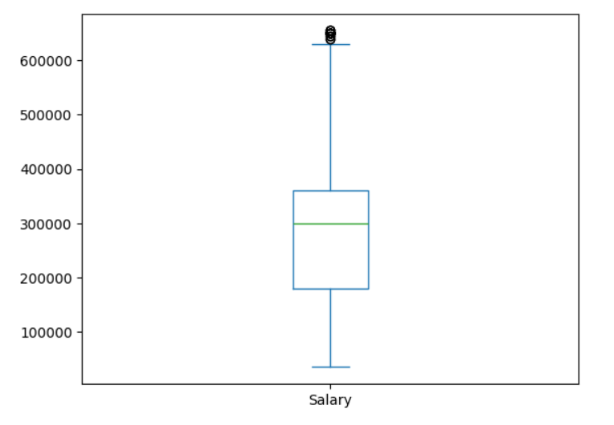
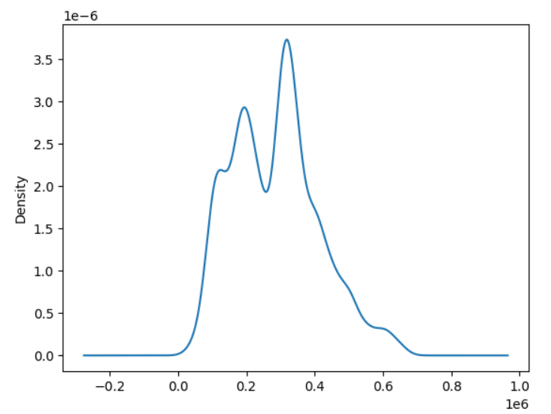
Univariate Analysis Steps
Identify Numerical Columns and perform BOXPLOT, KDE, HISTPLOT
Identify Categorical Columns and perform COUNTPLOT and BARPLOT

Slide 5
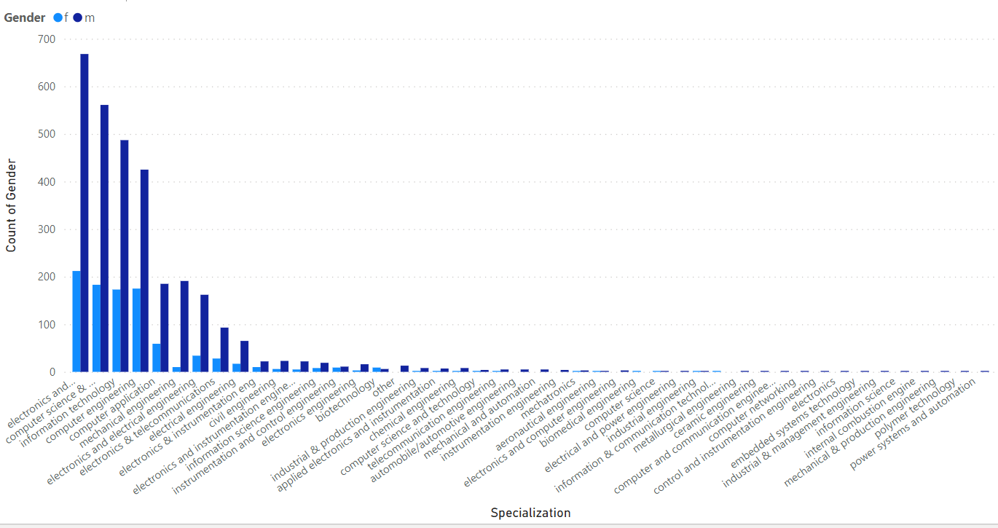
Bivariate Analysis Steps
Bi-variate analysis was performed, and Numerical vs Numerical Data was observed using a scatter plot for checking correlation.
Numerical vs Categorical Data was observed using a Box Plot for data distribution among different categories and observations were noted down.
Categorical vs Categorical Data was observed using a Stacked Bar Plot.
Here we can see the Stacked Bar plot for Gender and Specialisation.

Slide 6
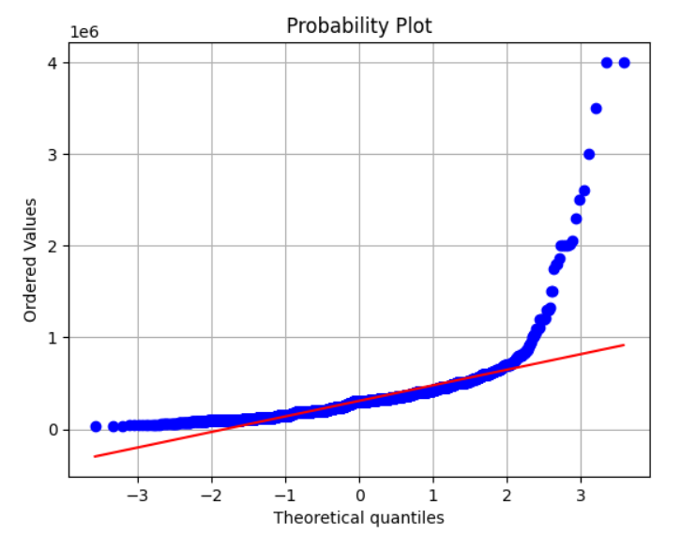
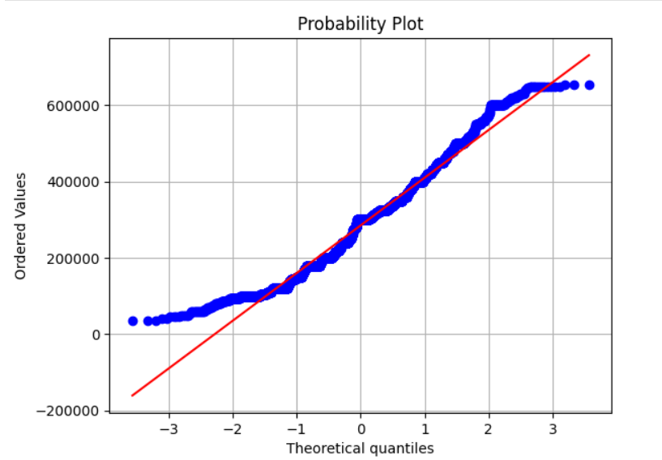
﻿-The total count of Gender was higher for males (3,041) than for females (957). ﻿-The average Count of Gender was higher for males (69.11) than for females (35.44). -The count of Gender for males and females diverged the most when the Specialization was electronics and communication engineering when males were 456 higher than females. QQ Plot before cleaning vs after cleaning

Slide 7
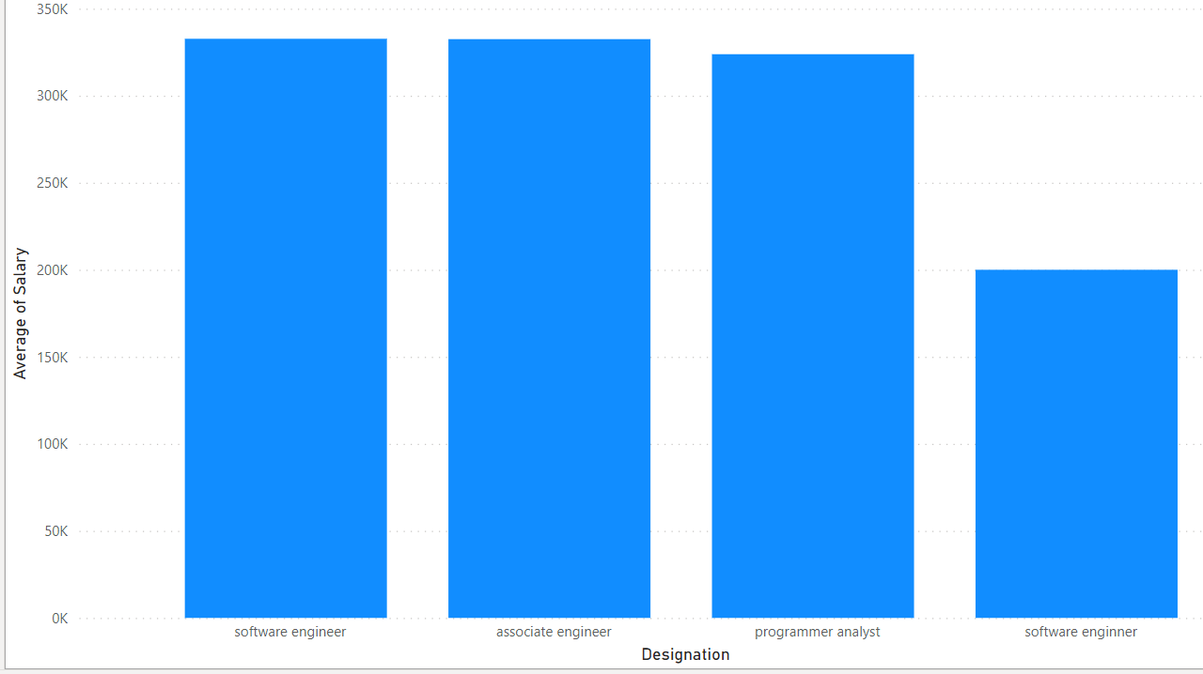
At 3,32,714.29, software engineers had the highest Average Salary and was 66.36% higher than software engineers, which had the lowest Average Salary at 2,00,000.00. ﻿Across all 4 Designation, the Average Salary ranged from 2,00,000.00 to 3,32,714.29.

Slide 8

THANK YOU

